Slide 2
Building a Microsoft Teams Bot using .NET and Teams Toolkit
John Miller
Senior Program Manager
@jmillerdev
Ayça Baş
Senior Cloud Advocate
@aycabs

Slide 3
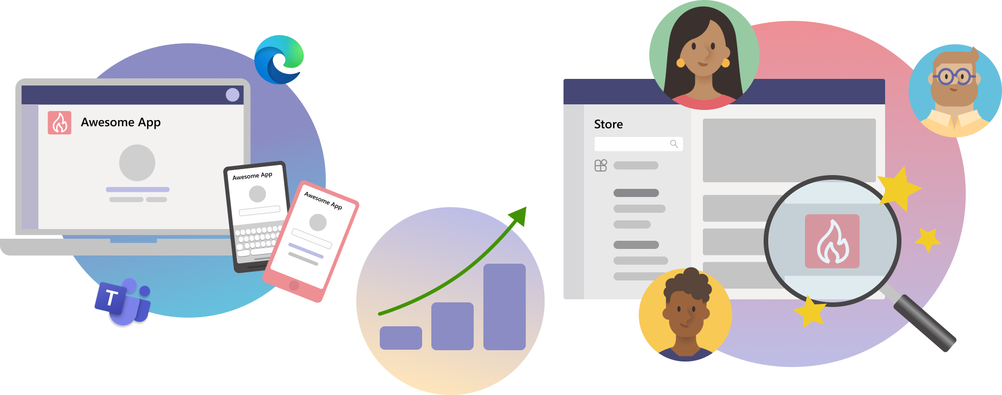
Agenda
Overview of Microsoft Teams Apps
Capabilities you can build for Microsoft Teams
Teams Toolkit for Visual Studio
Demo
Resources

Slide 4

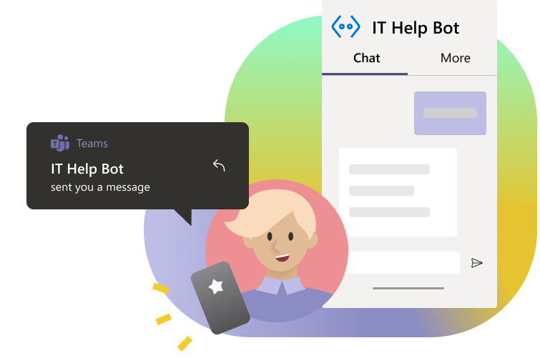
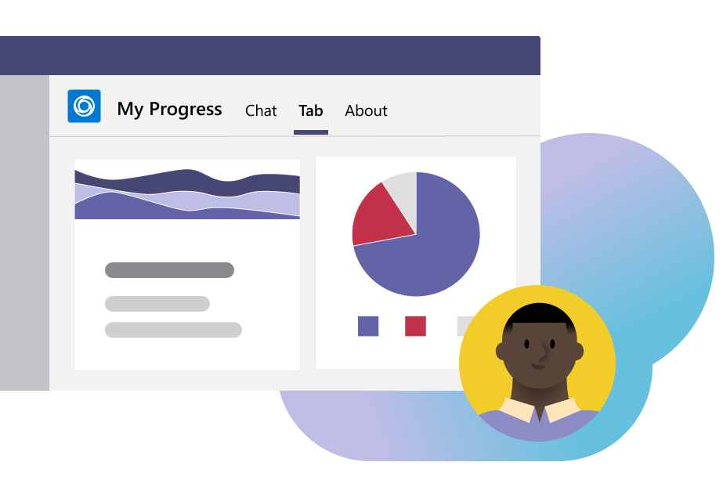
Why a Teams app?
Communication & Collaboration
Social interactions
Common business processes
Surface an existing app

Slide 5
Teams apps are the apps that…
Extend the capabilities of Microsoft Teams Platform
Can be personal or shared
Are web-based
Are hosted endpoints

Slide 6
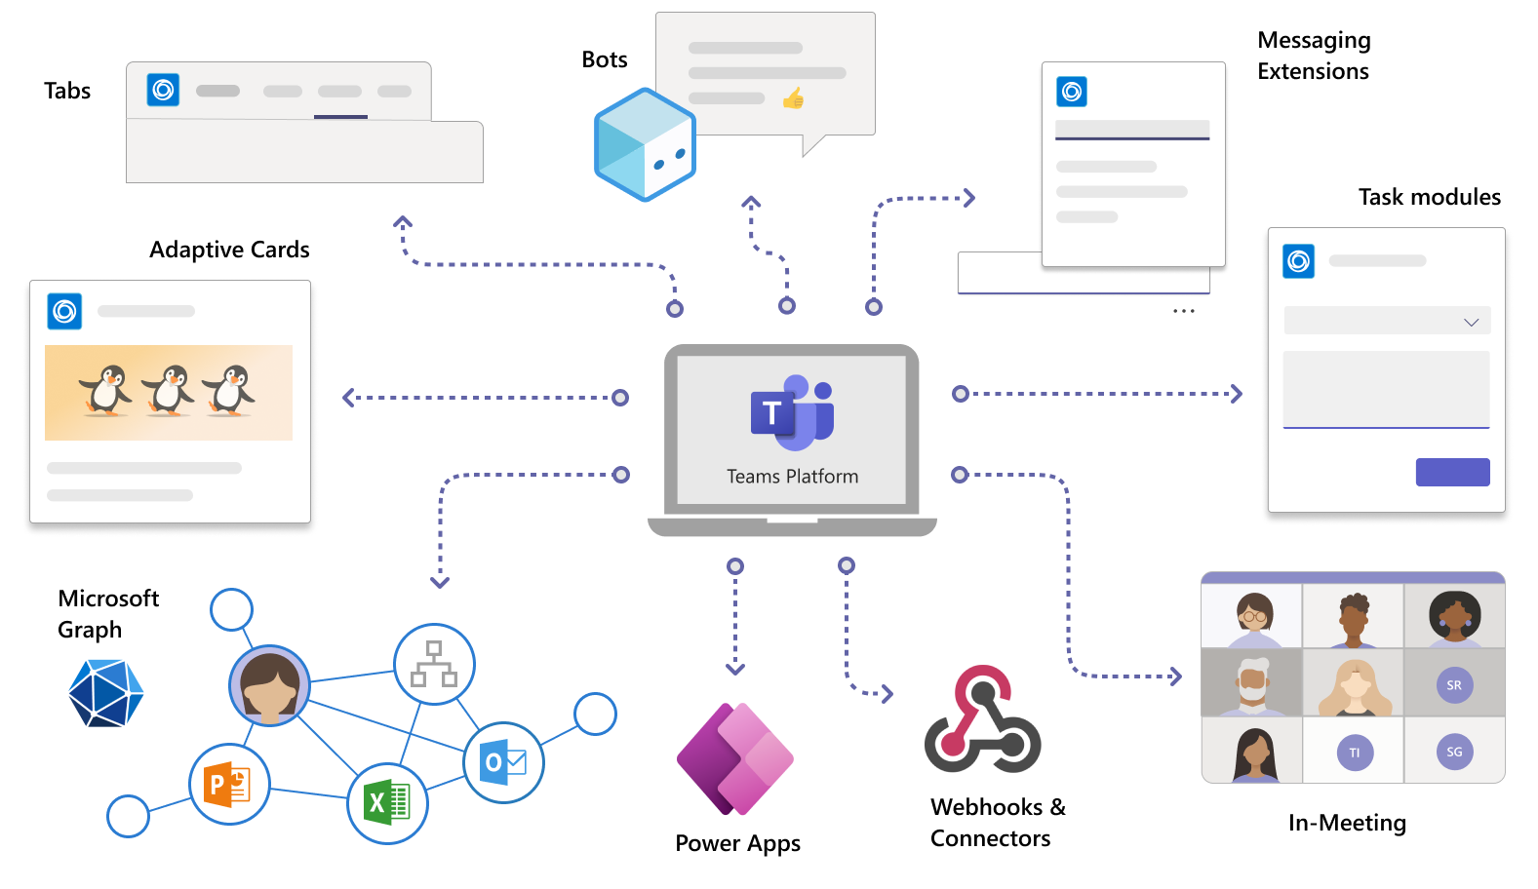
Capabilities you can build for Microsoft Teams

Slide 7
What is a Teams app?
{
"$schema": "https://developer.microsoft.com/json-schemas/teams/v1.14/MicrosoftTeams.schema.json",
"manifestVersion": "1.14",
"version": "1.0.0",
"id": "%MICROSOFT-APP-ID%",
"localizationInfo": {
"defaultLanguageTag": "en-us",
"additionalLanguages": [
{
"languageTag": "es-es",
"file": "en-us.json"
}
]
},
"developer": {
"name": "Publisher Name",
"websiteUrl": "https://website.com/",
"privacyUrl": "https://website.com/privacy",
"termsOfUseUrl": "https://website.com/app-tos",
"mpnId": "1234567890"
},
"name": {
"short": "Name of your app (<=30 chars)",
"full": "Full name of app, if longer than 30 characters (<=100 chars)"
},
"description": {
"short": "Short description of your app (<= 80 chars)",
"full": "Full description of your app (<= 4000 chars)"
},
"icons": {
"outline": "A relative path to a transparent .png icon — 32px X 32px",
"color": "A relative path to a full color .png icon — 192px X 192px"
} …
manifest.json
color.png
outline.png

Slide 8
What is a Teams app?
"staticTabs": [
{
"entityId": "unique Id for the page entity",
"scopes": [
"personal"
],
"context": [
"personalTab",
"channelTab"
],
"name": "Display name of tab",
"contentUrl": "https://contoso.com/content (displayed in Teams canvas)",
"websiteUrl": "https://contoso.com/content (displayed in web browser)",
"searchUrl": "https://contoso.com/content (displayed in web browser)"
}
],
"bots": [
{
"botId": "%MICROSOFT-APP-ID-REGISTERED-WITH-BOT-FRAMEWORK%",
"scopes": [
"team",
"personal",
"groupchat"
],
"needsChannelSelector": false,
"isNotificationOnly": false,
"supportsFiles": true,
"supportsCalling": false,
"supportsVideo": true,
"commandLists": [
{
"scopes": [
"team",
"groupchat"
…
manifest.json
color.png
outline.png

Slide 9

Publishing apps
To the store
Available for all Microsoft Teams customers to use
To a tenant
Available for specific companies, controlled by tenant admins
To a team
For testing purposes, or for apps designed for specific functions and teams

Slide 10
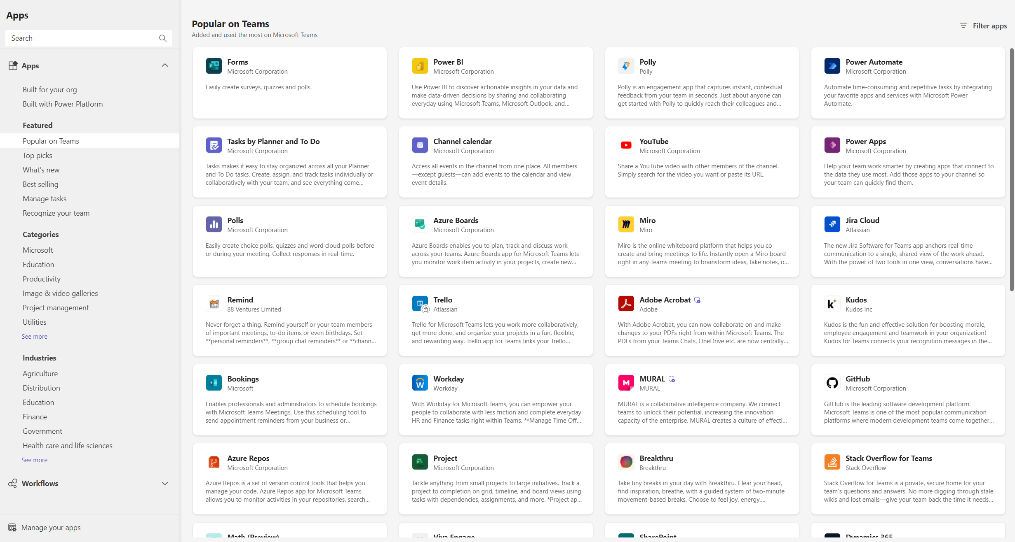
Apps available on Teams Store

Slide 11
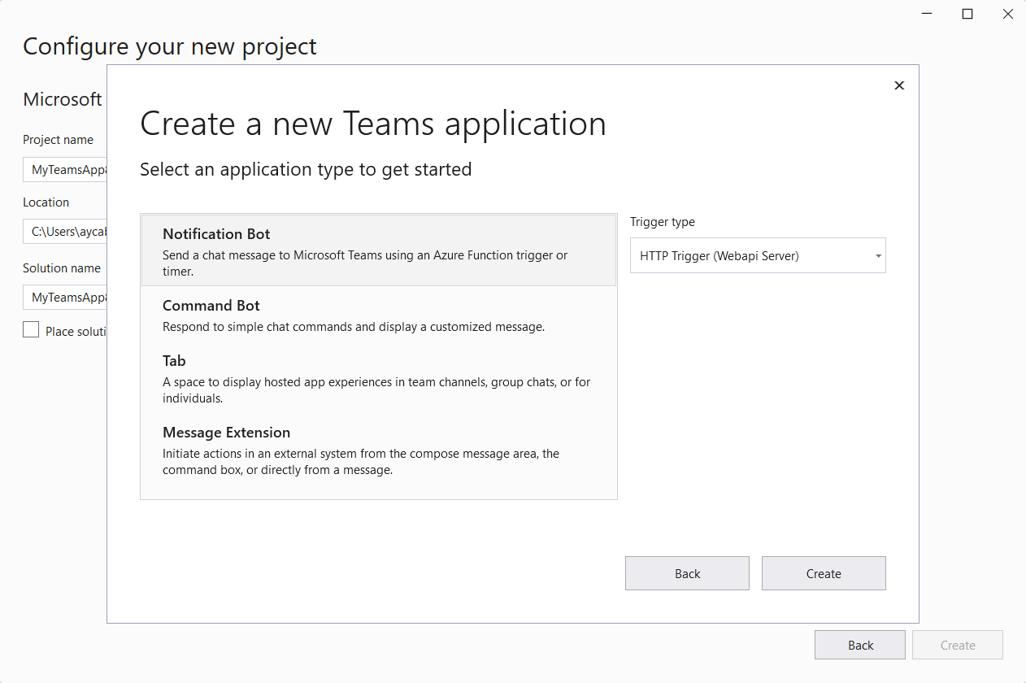

Teams Toolkit for Visual Studio

Slide 12
Demo – Build your first Teams bot
Teams Toolkit for Visual Studio and .NET

Slide 13
Why Teams Toolkit?
Simple way to get started with project templates
Save time with automatic app registration
Smart defaults for hosting in Azure
Use .NET!

Slide 14
TeamsFx .NET SDK
Helpful package that simplifies bot scenarios, identity, and more
Also includes interop types for Blazor projects to make building UI apps in Teams easier
Available on NuGet
public void ConfigureServices(IServiceCollection services)
{
...
services.AddTeamsFx(Configuration.GetSection("TeamsFx"));
}
…
await teamsUserCredential.GetTokenAsync(
new TokenRequestContext(new string[] { "User.Read" }),
new System.Threading.CancellationToken());

Slide 15
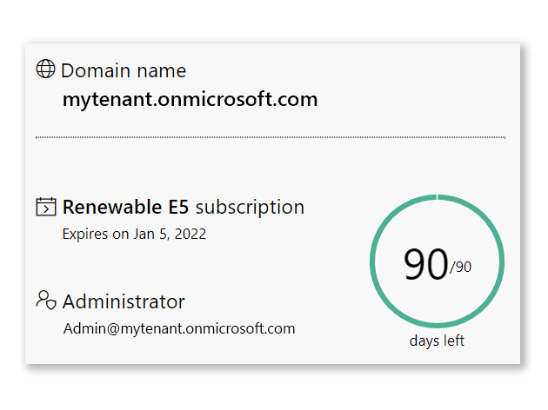
Microsoft 365 developer program
Get an instant sandbox preconfigured with sample data, including Teams Developer Portal, and start developing on the Microsoft 365 platform.

Slide 16
Teams Toolkit for Visual Studio documentation: https://aka.ms/teams-toolkit-vs/docs
TeamsFx GitHub: https://aka.ms/github/teamsfx
TeamsFx Samples: https://aka.ms/github/teamsfx-samples
[Tutorial🚀]
Build a stock update notification bot for Microsoft Teams using Teams Toolkit for Visual Studio: https://aka.ms/teams-toolkit-vs/bot-tutorial
Resources

Slide 17
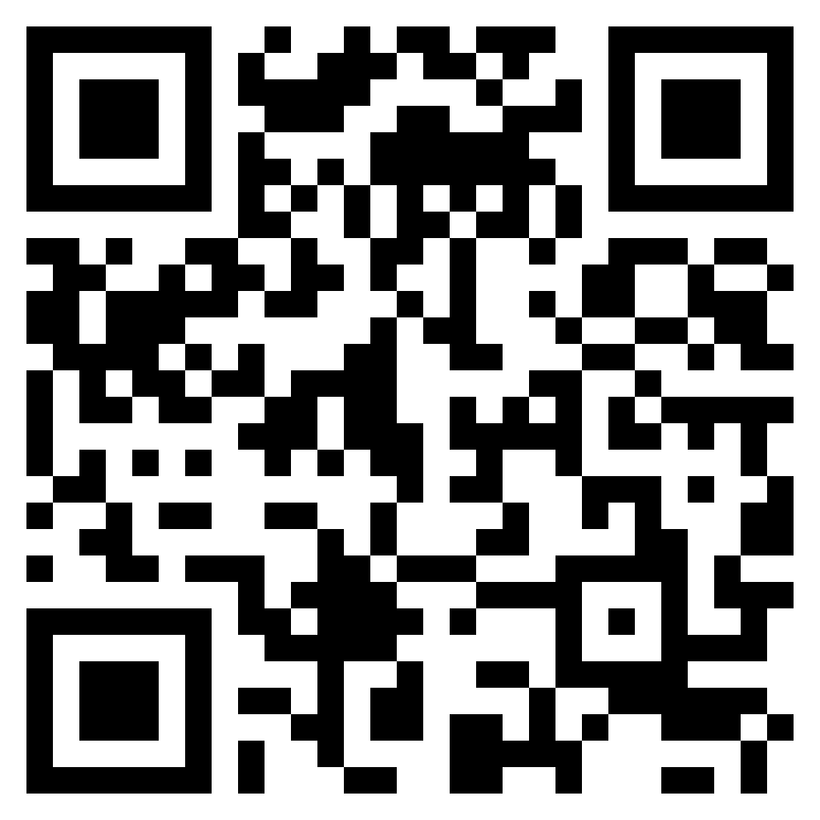
.NET Developers,
We’d like to hear from you!
Share your feedback 🙏
https://aka.ms/teams-toolkit-vs/feedback

